Slide 1
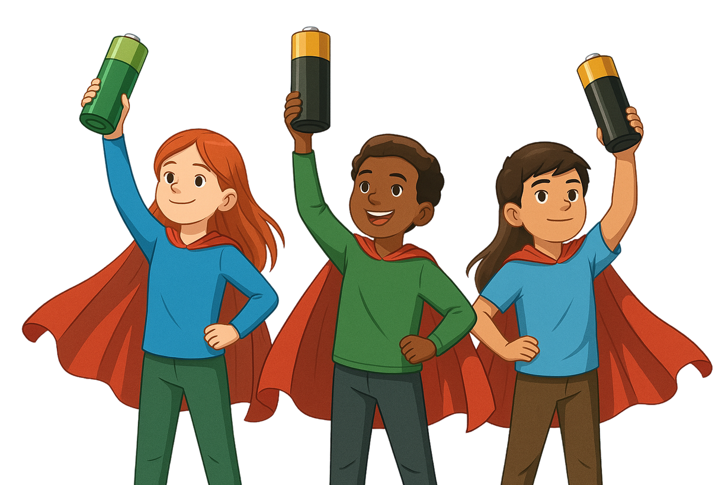

HOW TO BE A BATTERY HERO!
An introduction to battery recycling.
CLASSROOM PRESENTATION

Slide 2


TABLE OF CONTENTS
03
Meet Smarty & Boxer
Meet Smarty and Boxer, our battery recycling mascots, willing to help you in this battery recycling learning journey.
05
A little battery history
04
What is a battery?
When and how were batteries invented? Discover their history!
11
Definitions and fun resources to get familiar with the battery universe.
Why is it important to recycle batteries?
Recycling batteries helps protect the planet. Find out how.
06
The different types of batteries
Learn about the difference between single-use and rechargeable batteries
12
Collect, Protect, Drop Off
HI, I’M SMARTY THE SMART BATTERY CONTAINER! I’M SO HAPPY TO JOIN YOU ON THIS ADVENTURE!
Learn about the three steps to safely recycle batteries in your community.
07
How do batteries work?
Become a battery expert! Learn about the parts of a battery and how it generates electricity.
14
How are batteries recycled?
Learn the battery recycling journey.
08
Let’s make a lemon battery!
Use 5 juicy lemons to light up an LED bulb.
15
What can old batteries become?
10
Battery components can be used in new products. Find out how.
A raccoon’s guide to battery recycling
Watch a video and learn how animals recycle things, and why you should, too!
16
Fun games and activities
Have fun with our battery recycling games and activities!
02

Slide 3

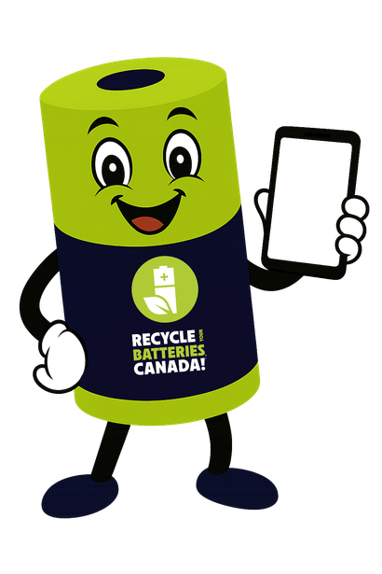

MEET SMARTY & BOXER
Meet Smarty, the Smart Battery Recycling Container, and his sidekick, Boxer, the Battery Recycling Box!
You can find Smarty and Boxer at thousands of retail stores, libraries, and municipal depots across Canada, making it convenient for people to drop off their used batteries for recycling.
Smarty has special sensors and a communication device that he can use to tell the nice people at Recycle Your Batteries, Canada! when he is nearly full of used batteries.
They can then send a delivery person to empty Smarty so he can begin collecting used batteries all over again.
Boxer is Smarty’s reliable friend. He is small, fast, and agile, so he can get into places Smarty can’t go. Boxer has a big appetite for used batteries, so feed him often! When he’s full, he catches a ride with a friendly delivery person back home to Recycle Your Batteries, Canada!
Find Smarty and Boxer in your community by visiting RecycleYourBatteries.ca.
WE GET TO MEET LOTS OF NICE PEOPLE WHO CARE ABOUT THE ENVIRONMENT.
HI, IT’S SMARTY!
I’M NEARLY FULL. CAN SOMEONE PLEASE COME AND EMPTY ME?
BOX! BOX!
03

Slide 4
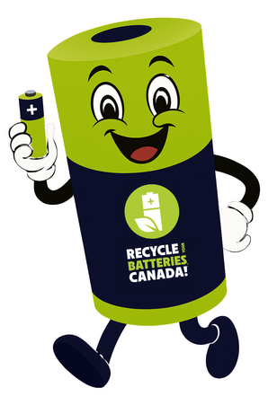
WHAT IS A BATTERY ?
SAY IT OUT LOUD :
BATTERY → BA-TUH-REE
DEFINITION:
ACTIVITY:
Find batteries around you. List products that use batteries. Write them below:
A battery is a device that stores electricity. It can be used to help operate portable items like toys, remote controls and tools, without them needing to be plugged in.
There are many different types of batteries, and most of them can be recycled.
Item 1:
Item 2:
Item 3:
Item 4:
Item 5:
Item 6 :
04

Slide 5
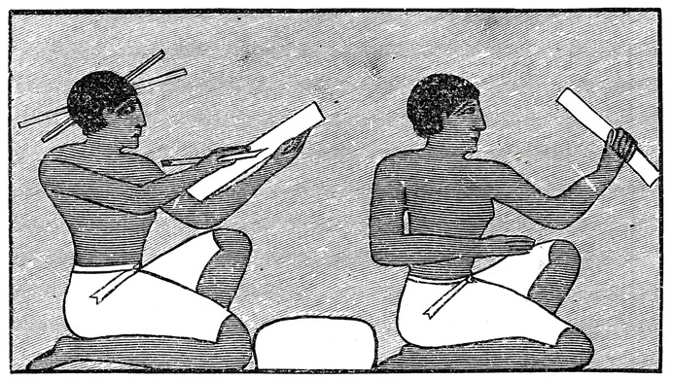
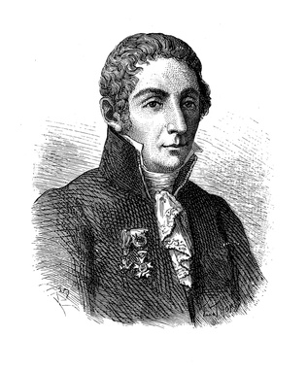
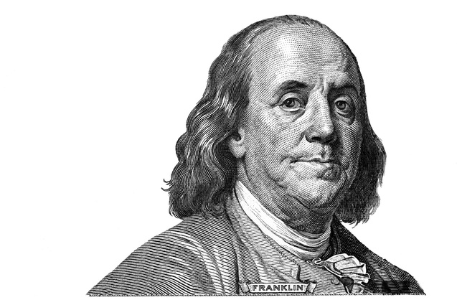
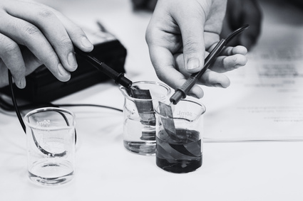
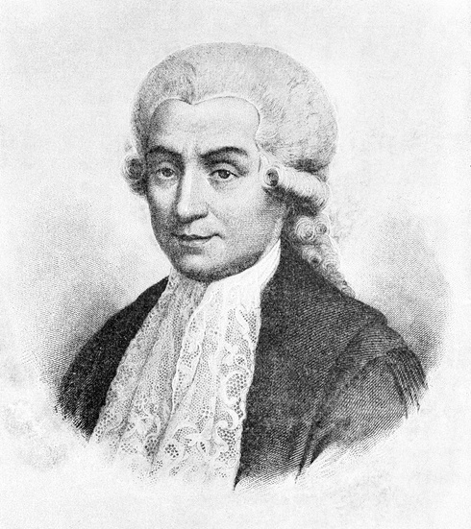
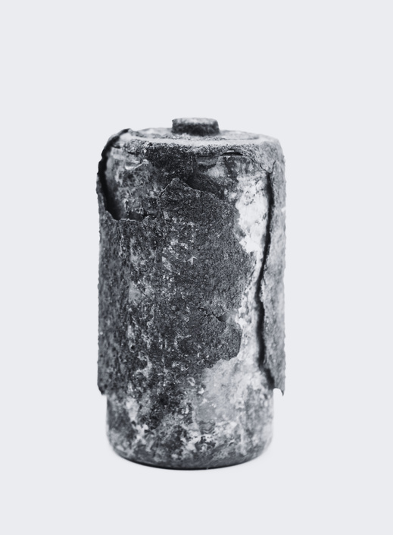
A LITTLE BATTERY HISTORY
BAGHDAD BATTERIES
FIRST BATTERY INVENTED
OVER 2000 YEARS AGO
Archeologists have discovered artifacts dating back to between 250 BC and 224 AD that could be considered early batteries. These terracotta pots had copper sheets and iron rods inside and may have been used to electroplate jewelry.
AROUND
1800
In 1800, Italian scientist Alessandro Volta invented the first battery: the voltaic pile.
He stacked copper and zinc discs with salty paper in between — and it created electricity!
FIRST USE OF THE WORD BATTERY
EARLY BATTERIES WERE JARS FILLED WITH LIQUID CHEMICALS
1748
Fun fact: the word “battery” was first used by Benjamin Franklin to describe an electric device.
He chose the word because it reminded him of a group of cannons fired together, also called a “battery”.
1800'S
They worked, but could spill easily. Later in the 1800's, scientists invented dry batteries that didn’t leak. These made batteries safer and portable — just like the ones we use today!
DISCOVERY OF ANIMAL ELECTRICITY
INVENTION OF DRY CELL BATTERIES
1791
In 1791, Luigi Galvani discovered something amazing: when he touched a dead frog’s leg with two different metals, it twitched like it was alive! He had just found out that electricity could make muscles move.
END OF 19TH
CENTURY
These batteries replaced the liquid chemicals of early batteries with a thick paste. This made portable electrical devices possible.
05

Slide 6
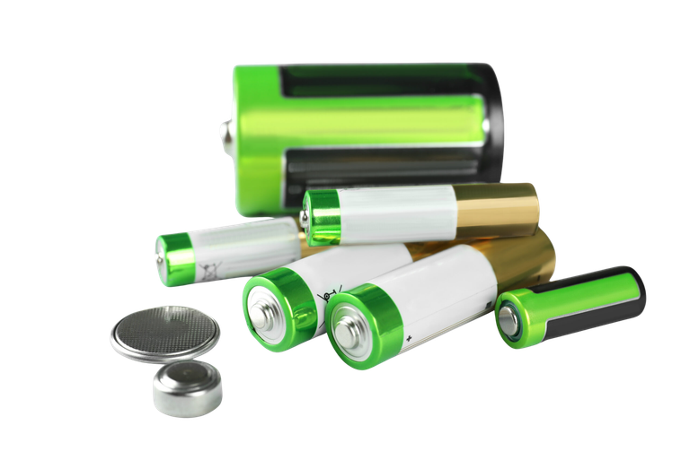
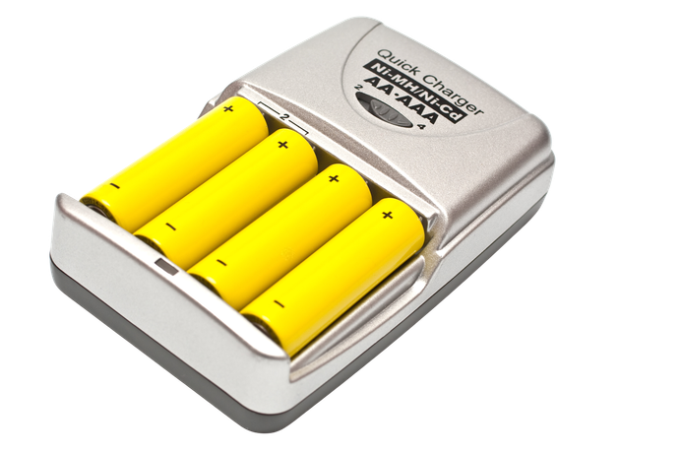
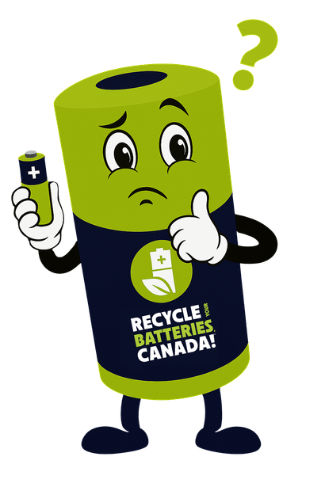

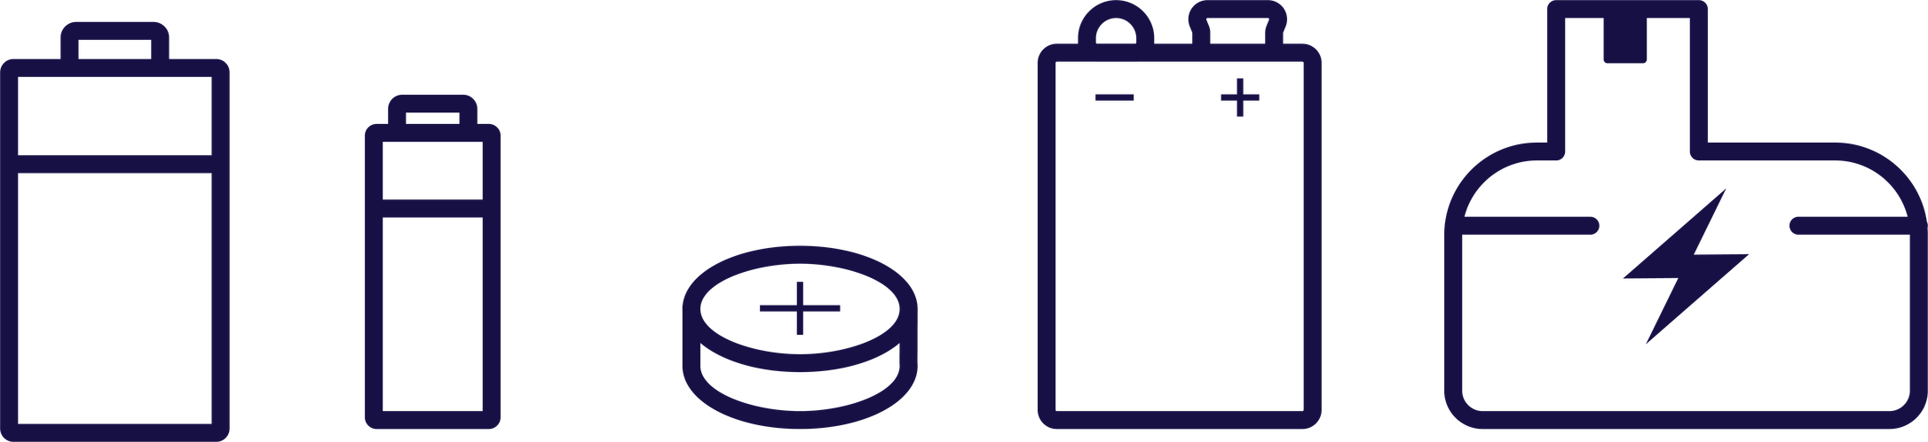
Single-Use Batteries: Also called primary batteries, or dry-cell single-use batteries, these are common household batteries that can’t be recharged and must be replaced once they run out of power.
WHAT ARE THE DIFFERENT TYPES OF BATTERIES?
Rechargeable Batteries: Also called secondary batteries, or storage batteries, these can be recharged many times. But over time, they lose power and, like single-use batteries, will eventually need to be replaced.
Batteries can come in many shapes and sizes. Here are just a few:
C, D
AA, AAA
Button
9V
Large Rechargeable
06

Slide 7

HOW DO BATTERIES WORK?
Think of the food that you eat. If you don’t eat enough, you may feel tired. When you eat, your body converts the food into energy that lets you run and jump. In a similar way, batteries store electrical energy, in the form of electrons, housed in special chemicals.
Let’s take a look at the simplified diagram above to see how a battery works. On the outside, there is a hard case, usually made of plastic. The ends, called terminals are made of metal and, can carry electricity. One terminal, called the anode has a negative sign (-). The other terminal, called a cathode has a positive sign (+).
The anode is filled with a chemical called electrolytes, which is filled with lots and lots of electrons. This acts as the fuel tank for the battery. The cathode is connected to a chemical such as manganese, that is hungry for electrons. It’s ready to absorb electrons.
The anode and cathode are separated by a barrier, otherwise the battery would short-circuit. The only way for the electrons to escape is through the terminals.
When we connect the battery to a device like a flashlight and turn it on, we create a circle called a circuit. This allows the electrons to travel from the anode to the cathode. Along the way, they travel through the flashlight’s wires, pass through the bulb, and electrons are used to light it up. That’s how the bulb lights up!
Over time, the chemicals in the battery get used up. Once that happens, the battery can’t produce electricity anymore. That’s when the battery must be recharged or recycled safely.
Cathode (+)
Casing
Manganese
Barrier
Electrolytes
Electrons
Anode (-)
Circuit
07

Slide 8
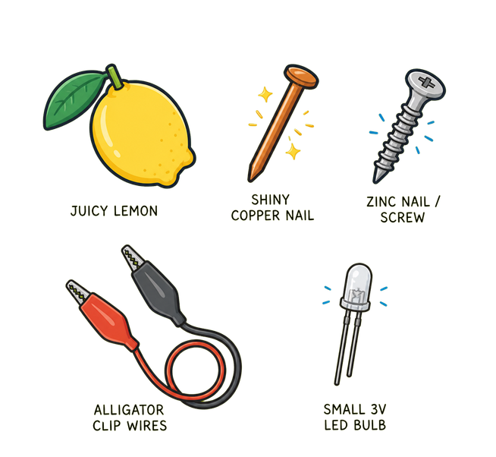
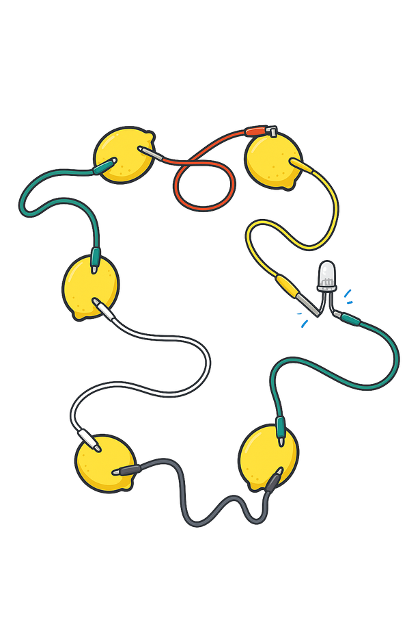
LET’S MAKE A LEMON BATTERY!
A FUN SCIENCE RECIPE, JUST FOR YOU!
🧪 INGREDIENTS:
  5 juicy lemons
  5 shiny copper nails
  5 zinc nails/ screws (or galvanized nails)
  5 alligator clip wires
  1 small 3V LED bulb
Tip: If you do not have alligator clip wires, you can also use standard electrical wires.
👩‍🍳 INSTRUCTIONS
  Roll your lemons gently on the table to get the juice flowing inside (but don’t break the skin!).
  Stick one copper nail and one zinc nail into each lemon, about 3 centimetres apart.
  Connect the Zinc nail from one lemon to the Copper nail on the next lemon using an alligator clip wire.
  Connect the Zinc nail on the second lemon to the copper nail on the third lemon and continue the process until all 5 lemons are connected in a line.
  Now, connect the Copper Nail on the first lemon and the Zinc nail on the 5th lemon to the 3V light bulb to complete a circle.
  Watch it light up — you’ve made electricity from lemons!
08

Slide 9

WHAT’S HAPPENING?
The lemon juice acts as the battery’s electrolyte, meaning it allows the flow of the electrical charge between the two metals. The penny acts as the cathode, or positive end, which attracts electrons. The nail acts as the anode, or negative end, which releases electrons. In this setup, electrons flow from the nail to the penny, just like in a real battery, creating an electric current.
SAFETY TIPS:
  Don’t taste the lemon after the experiment!
  Ask an adult to help you with the wires and bulb.
  Never open real batteries — they contain dangerous chemicals
09

Slide 10
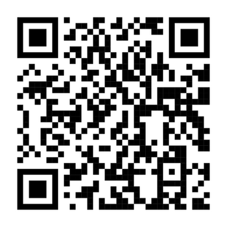
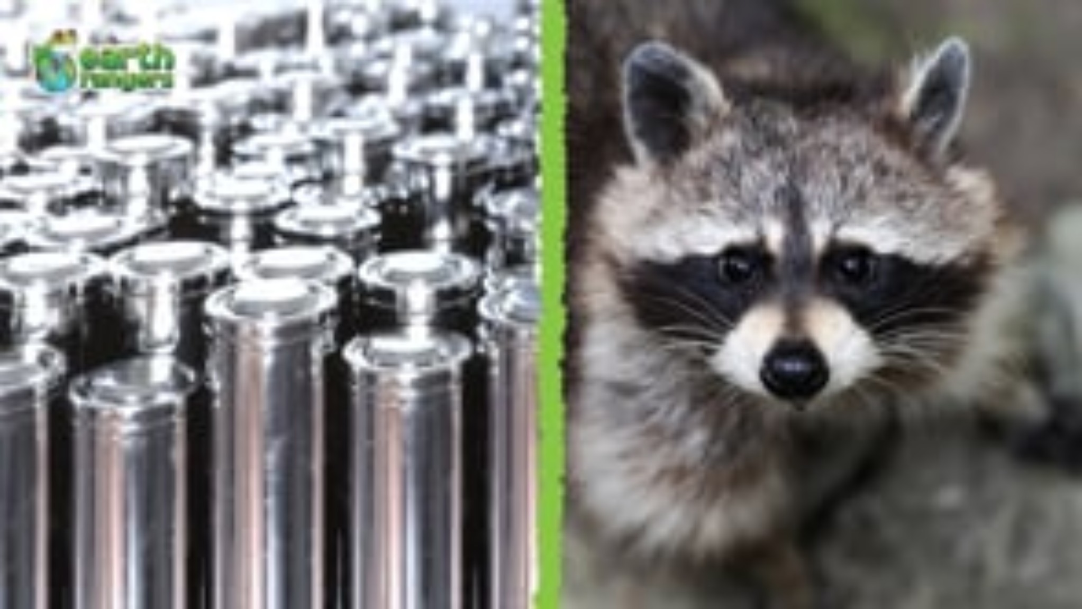
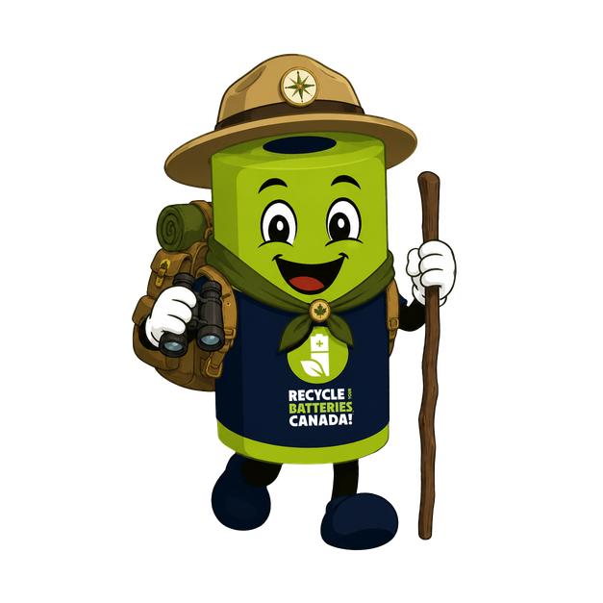

A RACCOON’S GUIDE TO BATTERY RECYCLING
Press play, scan the QR code or click this link to watch a video and learn how animals recycle things, and why you should, too!
HEY BOXER, HAVE YOU EVER SEEN A RACCOON RECYCLE
MATERIALS BEFORE?
HUMANS CAN LEARN A FEW THINGS FROM US ANIMALS!
10

Slide 11


WHY IS IT IMPORTANT TO RECYCLE BATTERIES?
PROTECT THE ENVIRONMENT
Batteries contain materials like lead, mercury, cadmium, and lithium. These can be very harmful to nature. If batteries go in the trash, they can leak into the ground or water and damage the planet. We recycle batteries to stop these toxic substances from causing harm.
PREVENT FIRES AND KEEP COMMUNITIES SAFE
If batteries are thrown in the trash, they can come into contact with metal objects and cause a spark, or even catch fire. Lithium-ion batteries can also catch fire if they are crushed in garbage trucks. It’s much safer for everyone when we recycle them the right way!
REDUCE WASTE AND RECOVER NATURAL RESOURCES
Batteries contain valuable metals like nickel and steel. If they end up in landfill, they’re lost forever. However, when batteries are recycled, these metals can be recovered and reused again and again!
Recycling also helps us reduce the need to mine new metals and saves a lot of energy.
FOLLOW THE RULES AND HELP YOUR COMMUNITY!
In many places in Canada, it’s the law to recycle batteries.
Programs like Recycle Your Batteries, Canada! have already collected millions of kilograms of batteries across the country! Your school or town may even have a battery bin — go check and become a Battery Hero where you live!
11
11

Slide 12
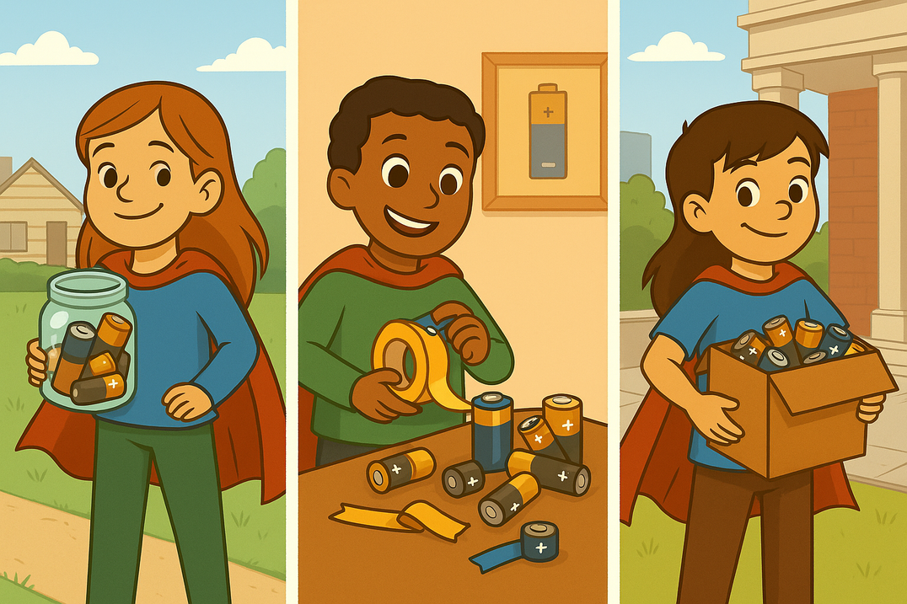
COLLECT, PROTECT, DROP OFF.
®
Follow these steps to safely recycle your
batteries and become a battery hero.
1. COLLECT
2. PROTECT
3. DROP OFF
Collect used batteries in a non-metal container like an old tomato sauce jar or peanut butter jar.
Place electrical tape over the terminals of lithium and rechargeable batteries, and alkaline batteries over 9V to prevent sparks. Keep them away from heat and sun until they are ready to go.
Drop off your batteries every three months to avoid corrosion. Find a drop-off location, by visiting RecycleYourBatteries.ca

Slide 13


FIND SMARTY AND BOXER
Smarty and Boxer are hiding in this picture. Can you find them?
  Use a computer to visit RecycleYourBatteries.ca.
  Enter your postal code to find the closest drop-off location.
  Write it below and tell your parents.
  Go visit Smarty and Boxer and drop off your used batteries!
FIND SMARTY AND BOXER IN YOUR COMMUNITY
My closest drop off location is:

Slide 14
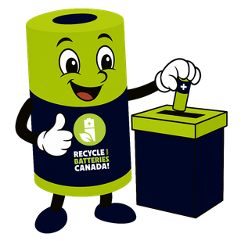
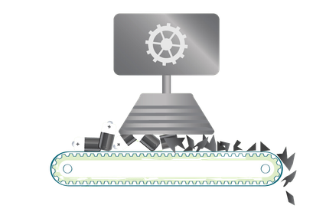
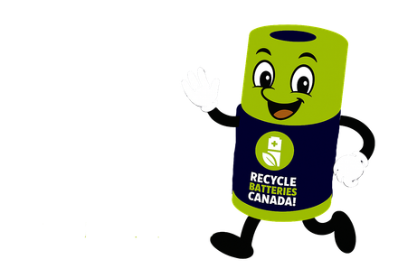
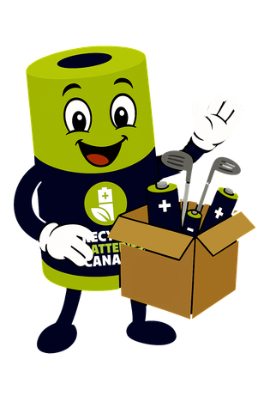
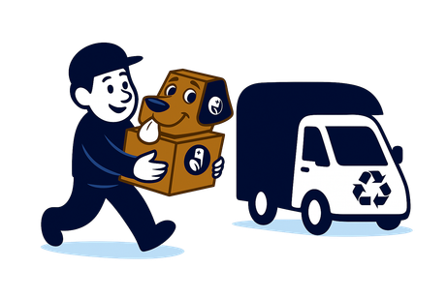
HOW ARE BATTERIES RECYCLED?
STEP 1 : COLLECTION
STEP 3: PROCESSING
People drop off used batteries into specially designated battery collection containers and boxes. It’s the first step to becoming a Battery Hero! It all starts with environmentally responsible people like YOU!
At the recycling plant, the batteries are safely taken apart.
Useful materials are separated and saved for reuse.
STEP 2: TRANSPORTATION & SORTING
STEP 4: NEW PRODUCTS CREATED
The batteries are taken by truck to a big recycling centre. There, they are sorted into different groups based on their battery chemistry.
Metals are melted down into blocks called ingots and shipped to factories where they can be reused in new products, like bikes, pots, or even new batteries!
14

Slide 15


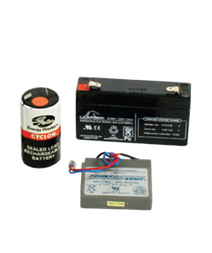
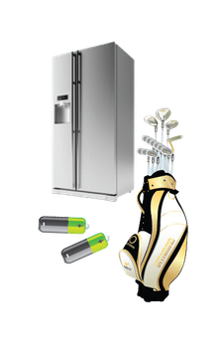
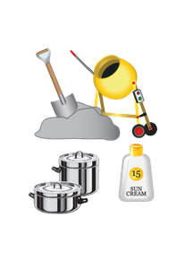
WHAT CAN OLD BATTERIES BECOME?
Batteries collected by Recycle Your Batteries, Canada! are transported to a facility where they are sorted according to type, size, shape and chemistry. Sorted batteries are then sent to processors where they are broken apart through a mechanical separation process.
The battery components are separated, and materials are reclaimed for use in the manufacturing of new products. Metals recovered are melted down and can become nearly anything! The possibilities are endless!
Used lead-based batteries can be recycled into new ones.
Used Lithium-Ion rechargeable batteries can be recycled into stainless steel which can be used to make silverware, golf clubs and even new batteries.
Used alkaline batteries can be recycled into steel and new products such as sunscreen, fertilizer and concrete.
15

Slide 16
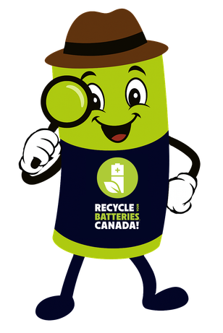


BATTERY WORDS YOU SHOULD KNOW AS A BATTERY HERO!
Write the letter of the matching definition.
A. The small metal parts on a battery that let power flow in and out.
B. To take something old and turn it into something new.
C. Using materials over and over instead of throwing them away.
D. When you give energy back to a battery, so it can work again.
___
recycle
___
collection
bin
___
hazardous
___
current
terminals
circular
economy
to process
___
recharge
___
___
___
___
electricity
___
environment
___
to sort
___
pollution
H. When people make the air, water, or land dirty, which can hurt people, animals and nature.
E. Something that can be dangerous for people and the planet.
F. To put things into groups based on what they are.
G. A special box where used batteries are dropped off safely.
I. The world around us, like nature, animals and land that we should protect.
J. The power we need to make things move or work, like turning on a light or using a toy.
K. To take something through steps to change or fix it.
L. The flow of tiny electric particles, called electrons, that move to make things work.
16

Slide 17
WHY IS IT IMPORTANT TO RECYCLE BATTERIES?
What are bad things that can happen when a battery is thrown in the garbage?
What are the possible benefits of recycling batteries properly?
What kind of products can be made from recycled batteries?
1 .
1 .
1 .
2 .
2 .
2 .
3 .
3 .
3 .
17

Slide 18
Battery Recycling Quiz
Name: ______________________ Class: ________
Circle or underline the correct answer for each question. Good luck!
Who invented the first modern battery in 1800?
a) Benjamin Franklin.
b) Alessandro Volta.
c) Thomas Edison.
d) Albert Einstein.
Which of these is NOT a good reason to recycle batteries?
a) Batteries contain harmful chemicals that can pollute the environment.
b) Materials from batteries can be reused to make new products.
c) Recycling batteries saves energy and resources.
d) Batteries will last forever if you recycle them.
What should you do with a used battery?
a) Throw it in the trash can.
b) Take it to a battery recycling drop-off box.
c) Flush it down the toilet.
d) Put it in the regular recycling bin.
True or False: Nearly all parts of an alkaline battery can be recovered and reused.
True / False
Which of these can old battery materials turn into after recycling? (Choose all correct answers.)
a) New batteries.
b) Metal items like golf clubs or pans.
c) Poisonous waste that nobody can use.
d) Ingredients for products like fertilizer.
18

Slide 19


BATTERY HUNT MISSION
Name: _________________ Date: ____________
“Battery Hunt” – Find the Batteries in Your Life!
We use batteries in so many things. In this activity, your mission is to find devices that use batteries at home (or in class) and list them below. Ask an adult to help you if needed. Talk about your discoveries in class!
Find at least 5 things that use batteries, like toys, gadgets or tools. If you’re not sure, ask an adult or check carefully. Example: TV remote, uses 2 AA batteries.
What type of battery does it use? If you know, write it down (AA, AAA, phone battery, watch battery, etc.). If not sure, you can leave it blank or guess (big or small?).
What type of battery does it use? If you know, write it down (AA, AAA, phone battery, watch battery, etc.). If not sure, you can leave it blank or guess (big or small?).
Have you ever changed that battery? Circle Yes or No. (If not, maybe it hasn’t died yet or someone else changed it.)
What does your family do with old batteries? (Don’t know? Ask! Some answers might be: throw it away, keep it, or recycle it!)
After your hunt: Which device had the most batteries in it at one time? _______________. Which battery was the biggest? ______________ (for example, a flashlight’s D battery) and the smallest? ______________ (for example, a watch battery).
Bring this sheet back to class. Be ready to share one surprise or thing you learned about batteries in your home!
GOOD LUCK, DETECTIVES!
19

Slide 20
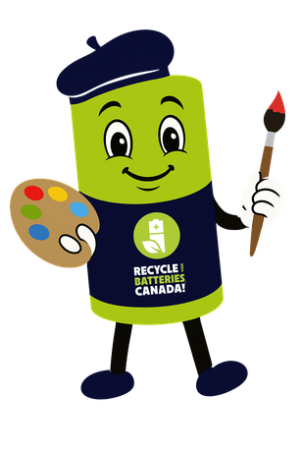

CREATE A POSTER
Let your creativity shine! Imagine you are an advertising expert assigned to create a poster to encourage people to recycle their used batteries. What message would you share? What would your poster look like? Draw it below!
20

Slide 21

FUNNY TRUE OR FALSE QUIZ
Test your knowledge! Read each sentence and check the right box.
You should store your used batteries in a metal bowl right next to the toaster.
Taping battery terminals helps prevent sparks.
Rechargeable batteries never need to be disposed of.
They can be recharged over and over forever.
True
False
True
False
True
False
Batteries love to take long naps in the trash can.
When you recycle your batteries, they might come back as a golf club or part of a bicycle!
True
False
True
False
21

Slide 22
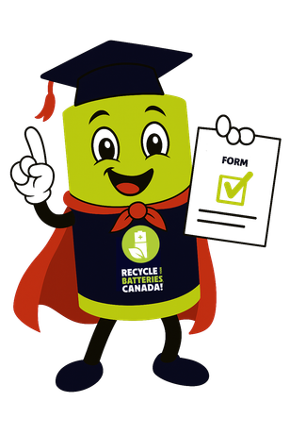

Fill out your Pledge Form:
My name is: _________________________
I promise to:
Never throw batteries in the garbage.
Help my family collect used batteries.
Bring used batteries to a recycling box.
Teach others what I’ve learned.
Be a Battery Hero, every day!
MY BATTERY HERO PROMISE
Now that you know how important battery recycling is, it’s your turn to take action! Are you ready to become a Battery Hero? Make your pledge below.
Signature: ___________________________
Date: _______________________________
22

Slide 23
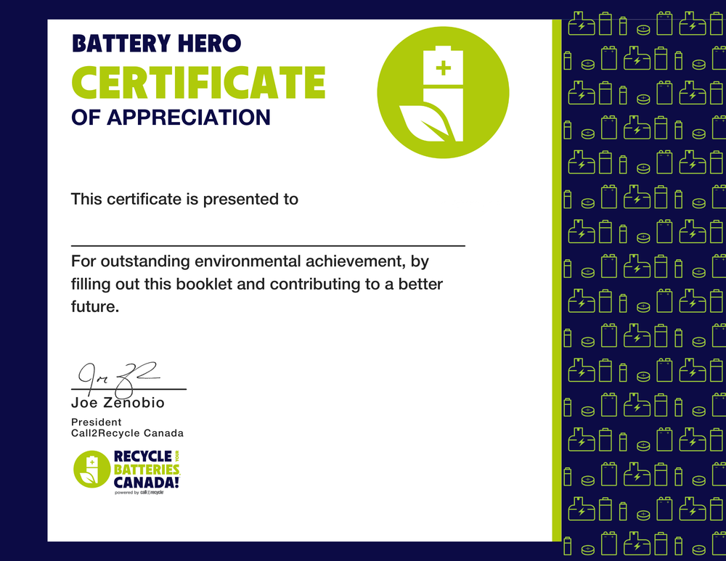
CONGRATULATIONS!
You did it! Thanks for helping protect the planet and learning so much! To celebrate your amazing work, here is your Battery Hero Certificate!
23

Slide 24

Recycle Your Batteries, Canada! Student Workbook Version 2. © Copyright 2026 Call2Recycle®. “Recycle Your Batteries, Canada! Powered by Call2Recycle”,
“Collect, Protect, Drop Off,” the battery and leaf logo, “Smarty” and “Boxer” and related marks are trademarks of Call2Recycle Canada, Inc.
PB55823

